Slide 1
Machine Learning Basics
Adapted from Lecture slides for Chapter 5 of Deep Learning
www.deeplearningbook.org
Ian Goodfellow
2016-09-26

Slide 2
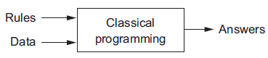
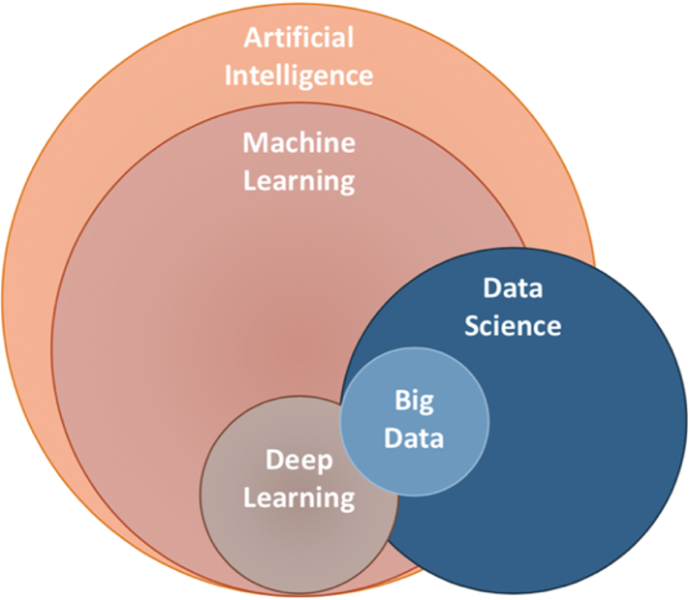
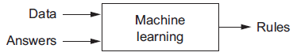
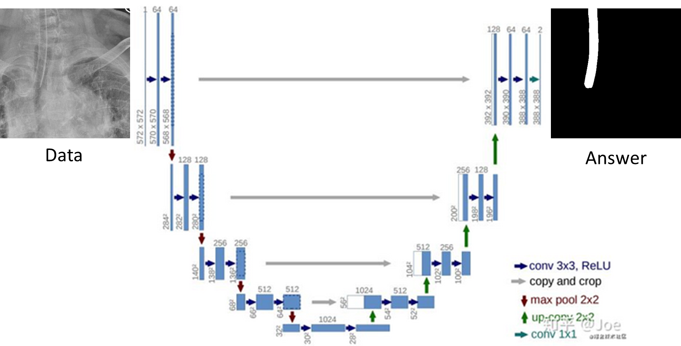
Machine learning:
a new programming paradigm

Slide 3
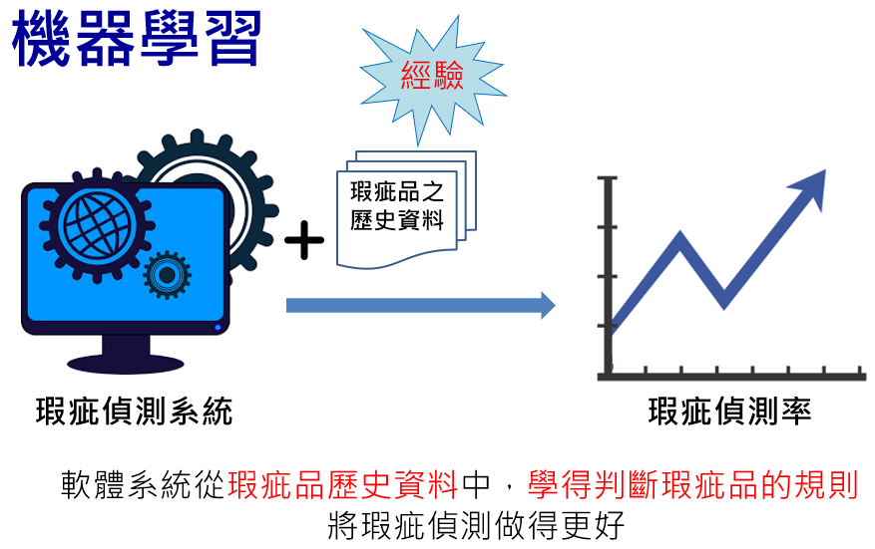

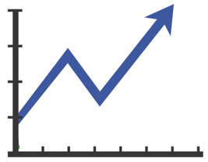

Machine Learning
A machine learning algorithm is an algorithm that is able to learn from data.
“A computer program is said to learn from experience E with respect to some class of tasks T and performance measure P, if its performance at tasks in T, as measured by P, improves with experience E.” -- Mitchell (1997)
T
P
E

Slide 4


傳統機器學習、資料探勘、大數據分析
評估
選擇重要因子
轉換名目因子
離散化數值因子
尺度不一
不平衡資料
…
預測之結果
探勘
正確率
召回率
精準率
敏感性
特異性
F1
ROC
均方差(MSE)
平均誤差
…
雜訊
離群值
缺失值
…
分類
迴歸
群聚分析
關聯分析
視覺化分析
…
支援決策
選擇與轉換
資料倉儲
清洗與整合
資料庫
檔案系統
前置處理
學習/探勘/分析
績效評估

Slide 5
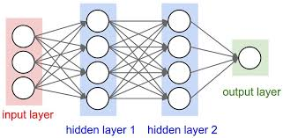
Performance Measure, P
To evaluate the abilities of a machine learning algorithm, a quantitative measure of its performance is needed.
For tasks such as classification, we often measure the accuracy of the model, or equivalently the error rate, the proportion of examples for which the model produces an incorrect output.
The performance is measured on a test set of data that is separate from the data used for training the machine learning system.
On training data
Accuracy?
Error rate?
Mean squared error?
On test data
Accuracy?
Error rate?
Mean squared error?
training data
train
~2/3
data
evaluate
~1/3
test data

Slide 6
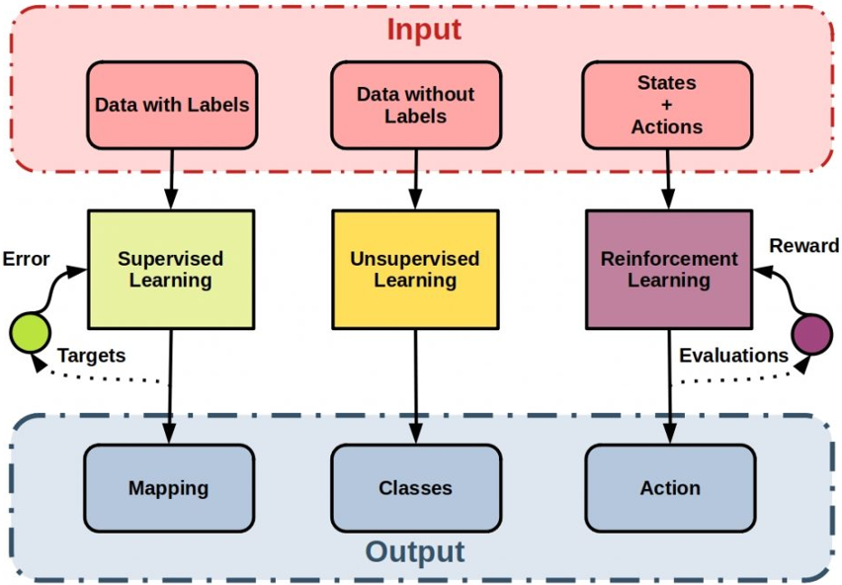
Category of Machine Learning Techniques
監督式學習
非監督式學習
增強式學習

Slide 7
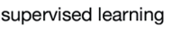
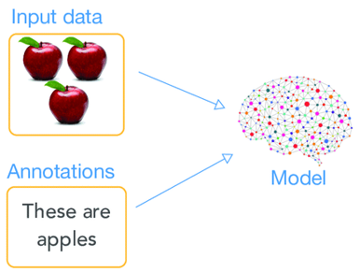
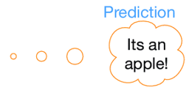



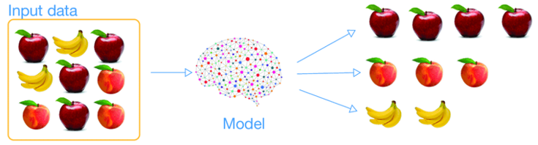
(監督式學習)
訓練模型
預測類別
(answer)
(非監督式學習)
群聚分析

Slide 8
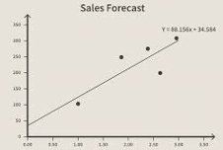
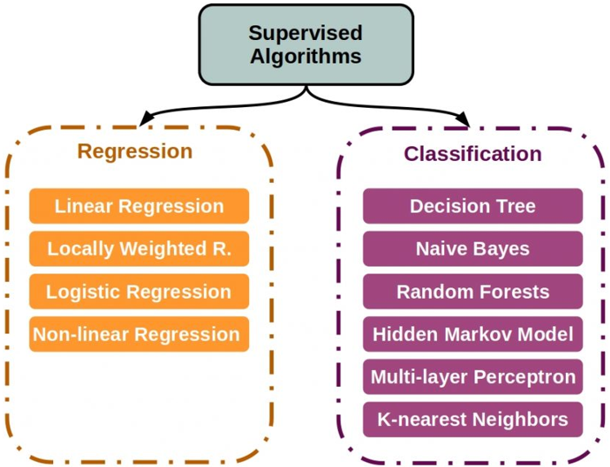
(監督式學習)
迴歸
分類

Slide 9
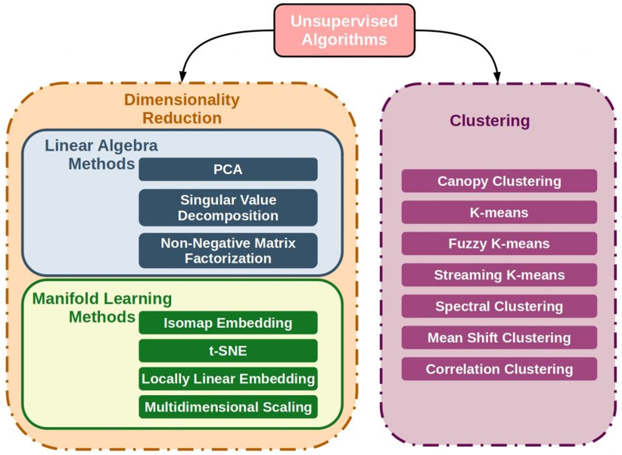
(非監督式學習)

Slide 10
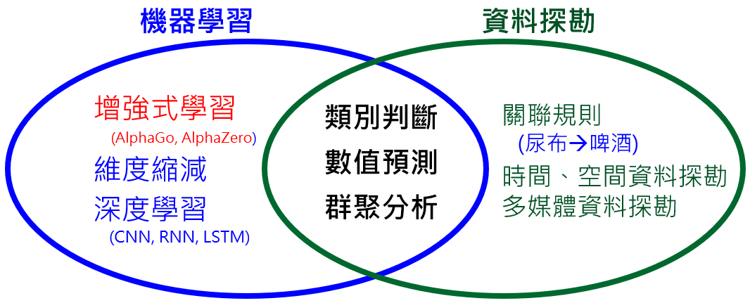
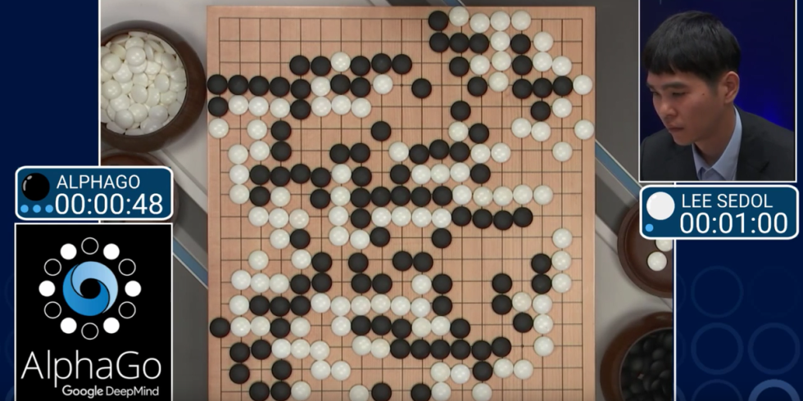
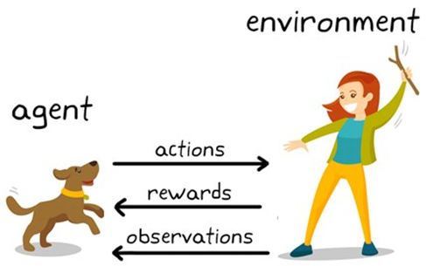
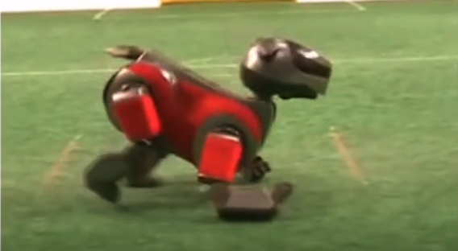
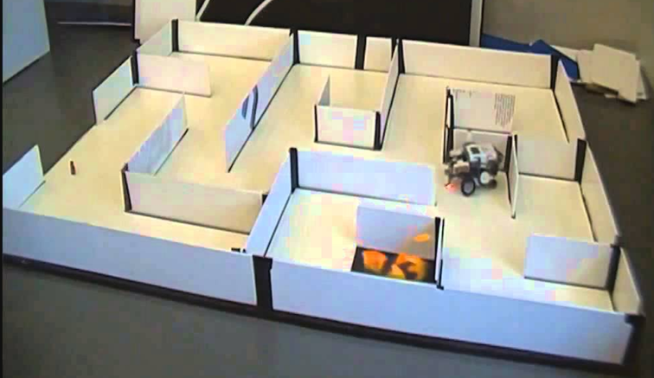
機器學習--增強式學習
(Reinforcement Learning, RL)
環境
報酬
狀態
行動
學習系統

Slide 11
Most common machine learning tasks
Classification
Regression
Machine translation
Transcription
Anomaly detection
Synthesis and sampling
Imputation of missing values
Denoising
Density estimation or probability mass function estimation
Structured output
Notes:
Transcription 抄寫

Slide 12
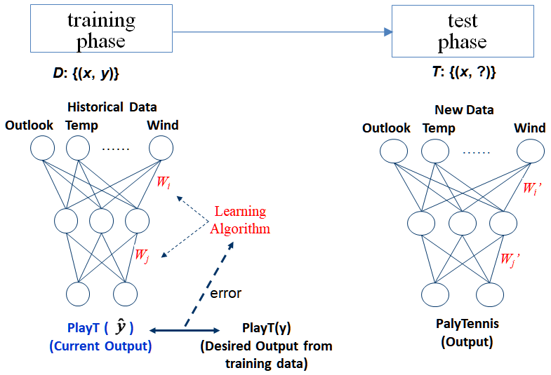
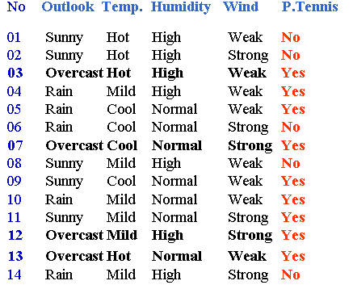
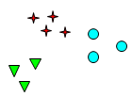
Type of Learning
Unsupervised learning
Answers are not given during learning, e.g. clustering
Supervised learning
to learn the relationship between features and class label
Answers are given during learning, e.g. training a classifier, regression
(features)
(answers)
(label)
Clustering the data according to feature attributes

Slide 13
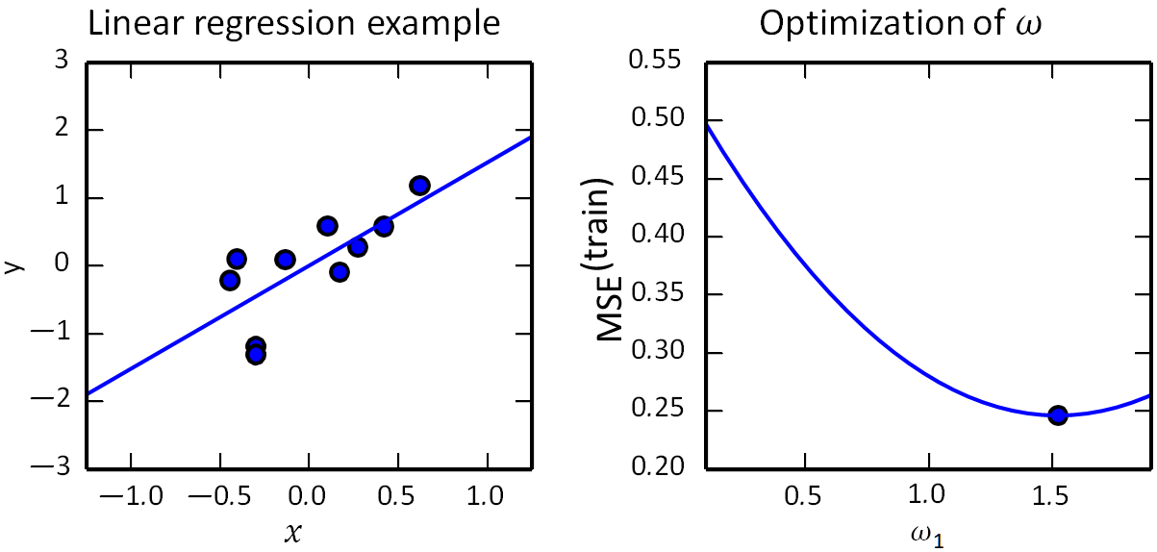
Example: Linear Regression
Given dataset D = {(x, y)}
Find relationship between y and x
y = w₁x
Example:
Given dataset D
D = {(0.7, 1.2) (0.5, 0.7) (0.4, 0.6) …}
Learn a linear function
y = 1.52 * x
Test
Given x = 0.8, what is y?
A linear regression problem, with a training set consisting of ten data points, each containing one feature. Because there is only one feature, the weight vector w contains only a single parameter to learn, w₁ .
(Left) Observe that linear regression learns to set w₁ such that the line y = w₁x comes as close as possible to passing through all the training points.
(Right) The plotted point indicates the value of w₁ found by the normal equations, which we can see minimizes the mean squared error (MSE) on the training set.

Slide 14
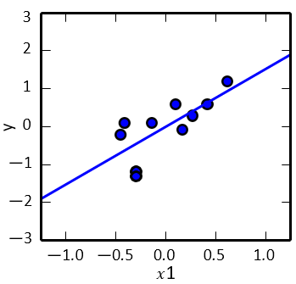
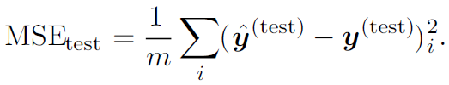
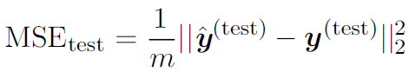
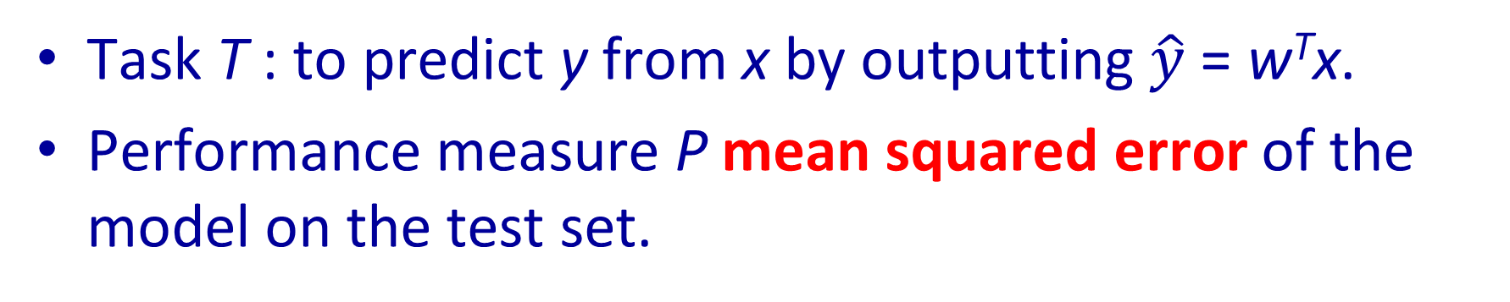
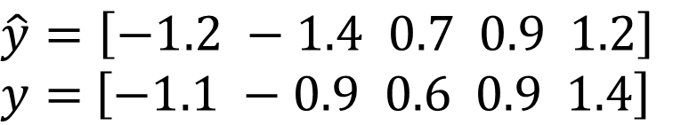
Example: Linear Regression
$$\hat{y}=\left[−1.2 −1.4 0.7 0.9 1.2\right]$$
$y=$ $\left[−1.1 −0.9 0.6 0.9 1.4\right]$
Task T : to predict y from x by outputting $\hat{y}$ = w^{T}x.
Performance measure P mean squared error of the model on the test set.
In other words, the error increases whenever the Euclidean distance between the predictions and the targets increases.
To gain experience E by observing a training set (X^{(train)}, y^{(train)}).
i.e., to minimize the mean squared error on the training set, MSE_{train} .

Slide 15
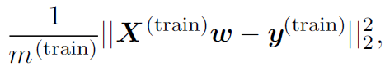
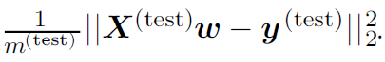
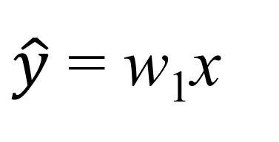
Generalization Error and Training Error
Generalization
the ability to perform well on previously unobserved inputs
Training error
error measure on the training set
Generalization error or test error
the expected value of the error on a new input.
$\hat{y}$ = w₁x
In linear regression example, we trained the model by minimizing the training error,
We actually care about the test error,

Slide 16
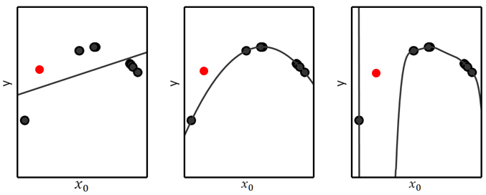
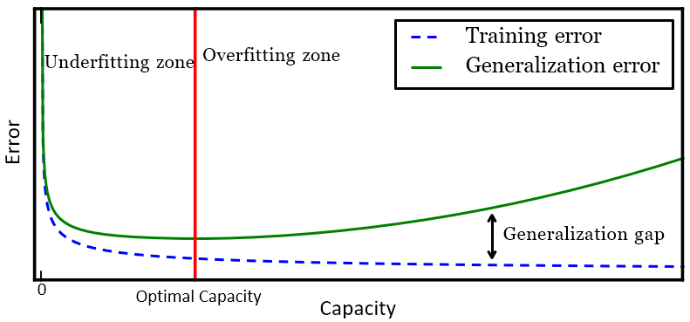
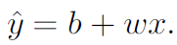
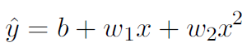
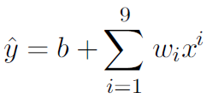
Capacity, Overfitting and Underfitting
A model’s capacity is its ability to fit a wide variety of functions.
Underfitting occurs when the model is not able to obtain a sufficiently low error value on the training set.
Overfitting occurs when the gap between the training error and test error is too large.
Overfitting: model performs well on training data but poor on test data

Slide 17
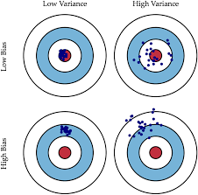
Capacity, Bias and Variance
Increase capacity
Underfitting zone
Overfitting zone
Generalization error
Bias
Variance
Optimal capacity
Capacity
As capacity increases (x-axis), bias (dotted) tends to decrease and variance (dashed) tends to increase, yielding another U-shaped curve for generalization error (bold curve).
If we vary capacity along one axis, there is an optimal capacity, with underfitting when the capacity is below this optimum and overfitting when it is above.

Slide 18
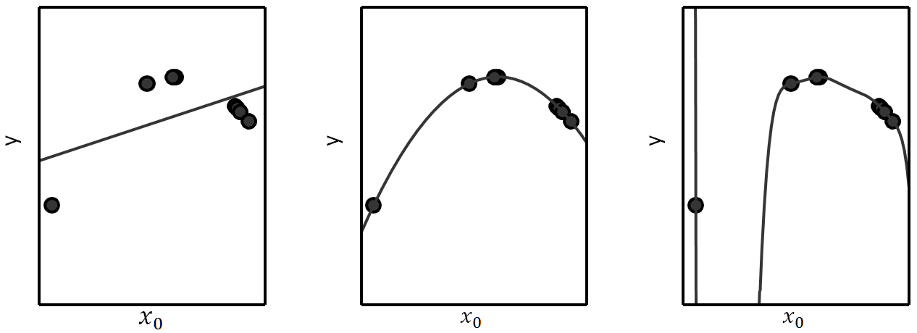
Capacity, Overfitting and Underfitting
Models with low capacity may struggle to fit the training set.
Models with high capacity can overfit by memorizing properties of the training set that do not serve them well on the test set.
(Left) A linear function fit to the data suffers from underfitting—it cannot capture the curvature that is present in the data.
(Center) A quadratic function fit to the data generalizes well to unseen points. It does not suffer from a significant amount of overfitting or underfitting.
(Right) A polynomial of degree 9 fit to the data suffers from overfitting.

Slide 19
Regression with Polynomials
A polynomial of degree one gives us the linear regression model with which we are already familiar, with prediction
To learn a model that is quadratic as a function of x:
The output is still a linear function of the parameters, so we can still use the normal equations to train the model in closed form.
To obtain a polynomial of degree 9:

Slide 20
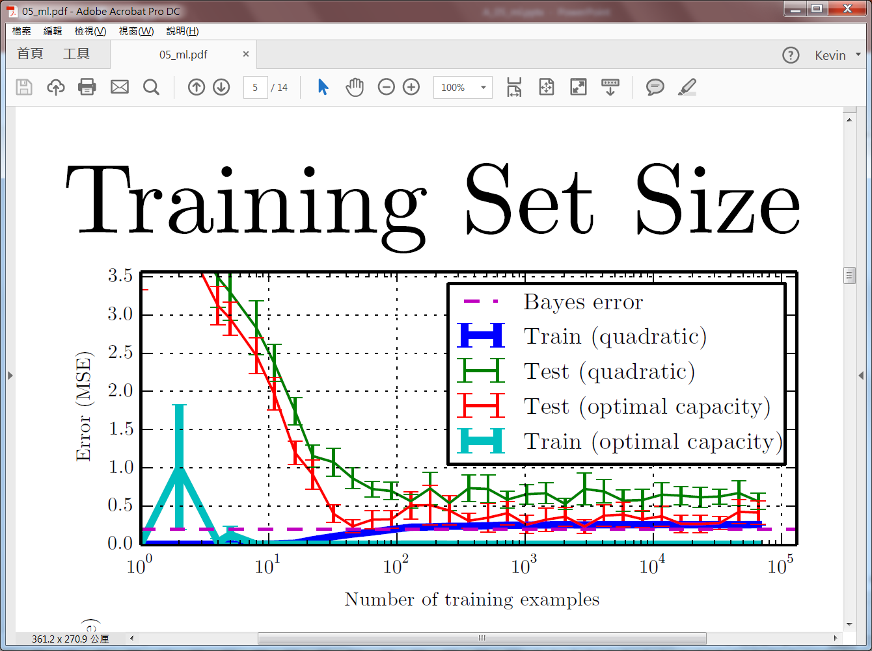
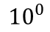
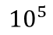
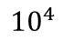
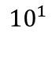
Training Set Size
For the quadratic model, the training error increases as the size of the training set increases. This is because larger datasets are harder to fit. Simultaneously, the test error decreases, because fewer incorrect hypotheses are consistent with the training data.
The quadratic model does not have enough capacity to solve the task, so its test error asymptotes to a high value.
The test error at optimal capacity asymptotes to the Bayes error. The training error can fall below the Bayes error, due to the ability of the training algorithm to memorize specific instances of the training set.
As the training size increases to infinity, the training error of any fixed-capacity model (here, the quadratic model) must rise to at least the Bayes error.
As the training (Bottom) set size increases, the optimal capacity (shown here as the degree of the optimal polynomial regressor) increases.
The optimal capacity plateaus after reaching sufficient complexity to solve the task.
Error (MSE)
Number of training examples
Optimal capacity (polynomial degree)
20
15
10
5
0
$${10}^{2} { 10}^{3}$$
$${10}^{0}$$
$${10}^{1}$$
$${10}^{4}$$
$${10}^{5}$$
Number of training examples

Slide 21
No Free Lunch Theorem
The no free lunch theorem for machine learning (Wolpert, 1996)
averaged over all possible data generating distributions, every classification algorithm has the same error rate when classifying previously unobserved points.
i.e., no machine learning algorithm is universally any better than any other.
The goal of machine learning research is not to seek a universal learning algorithm or the absolute best learning algorithm.
The goal is to understand
what kinds of distributions are relevant to the “real world” that an AI agent experiences, and
what kinds of machine learning algorithms perform well on data drawn from the kinds of data generating distributions we care about.

Slide 22
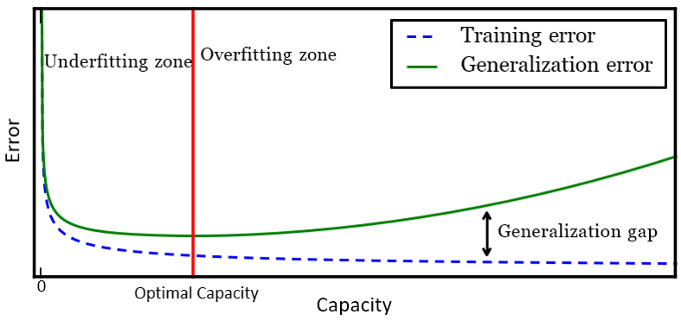
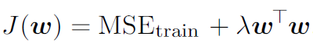
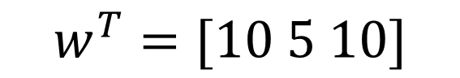
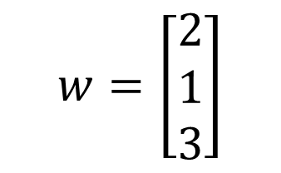
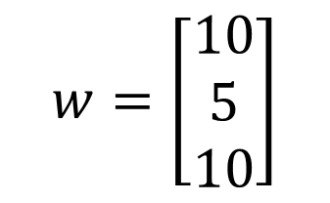
Regularization
Regularization
any modification we make to a learning algorithm that is intended to reduce its generalization error but not its training error.
The no free lunch theorem has made it clear that there is no best machine learning algorithm, and, in particular, no best form of regularization.
Weight decay
minimize a sum comprising both the mean squared error on the training and a criterion J(w) that expresses a preference for the weights to have smaller squared L2 norm.
When λ = 0, we impose no preference, and larger λ forces the weights to become smaller.
$$w=\left[\begin{matrix}10 \\ 5 \\ 10\end{matrix}\right]$$
$$w=\left[\begin{matrix}2 \\ 1 \\ 3\end{matrix}\right]$$
$$w^{T}=[10 5 10]$$

Slide 23
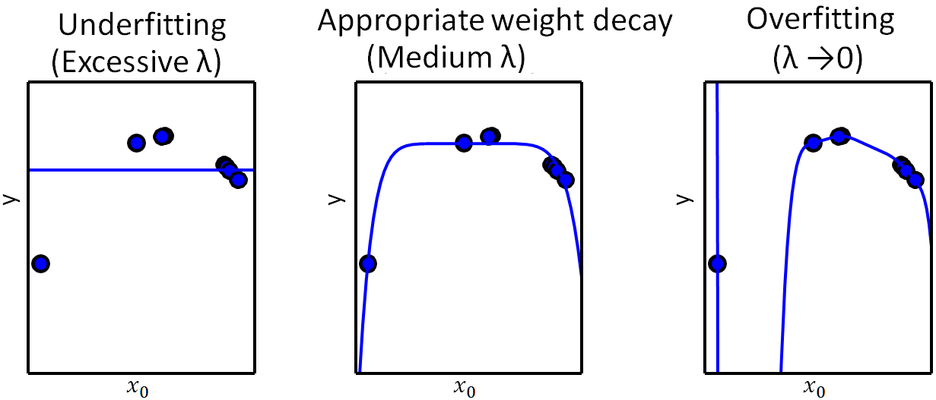

Weight Decay
Loss function:
The true function is quadratic, but here we use only models with degree 9. We vary the amount of weight decay to prevent these high-degree models from overfitting.
(Left) With very large λ, we can force the model to learn a function with no slope at all. This underfits because it can only represent a constant function.
(Center) With a medium value of λ, the learning algorithm recovers a curve with the right general shape. Even though the model is capable of representing functions with much more complicated shape, weight decay has encouraged it to use a simpler function described by smaller coefficients.
(Right) With weight decay approaching zero (i.e., using the Moore-Penrose pseudoinverse to solve the underdetermined problem with minimal regularization), the degree-9 polynomial overfits significantly,

Slide 24
Validation Set
Split the training data into two disjoint subsets
One of these subsets is used to learn the parameters
The other subset is our validation set, used to estimate the generalization error during or after training, allowing for the hyperparameters to be updated accordingly
Typically, one uses about 80% of the training data for training and 20% for validation
After all hyperparameter optimization is complete, the generalization error may be estimated using the test set.
Data
X
Training data
Test
data
70%
30%
Training data
Validation
data
Test
data
Error on validation set
70% (80%+20%)
30%

Slide 25


Bias and Variance
Bias and variance measure two different sources of error in an estimator
The bias of an estimator is defined as:
where the expectation is over the data (seen as samples from a random variable) and θ is the true underlying value of θ used to define the data generating distribution.
An estimator $\hat{θ}$_{m} is said to be unbiased if bias($\hat{θ}$_{m}) = 0, which implies that E($\hat{θ}$_{m}) = θ.
An estimator $\hat{θ}$_{m} is said to be asymptotically unbiased if lim m→∞ bias($\hat{θ}$_{m}) = 0, which implies that lim m→∞ E($\hat{θ}$_{m}) = θ.

Slide 26



Variance and Standard Error
The variance of an estimator is simply the variance
where the random variable is the training set.
The square root of the variance is called the standard error, denoted SE($\hat{θ}$)
The variance or the standard error of an estimator provides a measure of
how we would expect the estimate we compute from data to vary as we independently resample the dataset from the underlying data generating process.
2/3
train
training
data
evaluate
1/3
test

Slide 27



Trading off Bias and Variance to Minimize Mean Squared Error
Alternatively, we can also compare the mean squared error (MSE) of the estimates
Desirable estimators are those with small MSE and these are estimators that manage to keep both their bias and variance somewhat in check
θ

Slide 28


K-Fold Cross-Validation
The most common way to negotiate this trade-off is to use cross-validation.
Empirically, cross-validation is highly successful on many real-world tasks.
A partition of the dataset is formed by splitting it into k non-overlapping subsets.
The test error may then be estimated by taking the average test error across k trials.

Slide 29



5-Fold Cross Validation
A Real Case: Medical Image Segmentation
 | loss | iou_score | cm誤差 | 0.5cm內 | 1cm內
Fold1 | 0.07130 | 0.8891 | 0.2151 | 0.9592 | 1.0000
Fold2 | 0.07516 | 0.8748 | 0.5264 | 0.7755 | 0.9388
Fold3 | 0.07198 | 0.8766 | 0.381 | 0.8163 | 0.8571
Fold4 | 0.07606 | 0.8692 | 0.4252 | 0.7755 | 0.9592
Fold5 | 0.06874 | 0.8836 | 0.3359 | 0.8776 | 0.9592
Average | 0.07264 | 0.8787 | 0.3767 | 0.8408 | 0.9429

Slide 30





Maximum Likelihood Estimation
Ans1 = $\max_{x_{i}}$ {x₁ = 5, x₂ = 9, x₃ = 6}
Ans2 = arg $\max_{x_{i}}{\text{\{}\text{x}\text{1} \text{= }\text{5}\text{, }\text{x}\text{2} \text{= }\text{9}\text{, }\text{x}\text{3} \text{= }\text{6}\text{\} }}$
Most modern neural networks are trained using maximum likelihood.
Consider a set of m examples X = {x⁽¹⁾, . . . , x^{(m)}} drawn independently from the true but unknown data generating distribution p_{data}(x).
Let p_{model}(x; θ) be a parametric family of probability distributions over the same space indexed by θ.
p_{model}(x; θ) maps any configuration x to a real number estimating the true probability p_{data}(x).
The maximum likelihood estimator for θ is then defined as
X ={x^{(i)}}
$$p\left(\text{x}\text{(}\text{i}\text{)};θ\right)?$$
$$p\left(X;θ\right)?$$
Which one is more likely to generate the dataset X?
θ₁ = (μ=0, σ=1)
θ₂ = (μ=5, σ=3)
$$p\left(X;θ_{1}\right)? p\left(X;θ_{2}\right)?$$
$$\max_{θ}{p\left(X;θ\right)}$$

Slide 31





Maximum Likelihood Estimation
Ans1 = $\max_{x_{i}}$ {x₁ = 5, x₂ = 9, x₃ = 6}
Ans2 = arg $\max_{x_{i}}{\text{\{}\text{x}\text{1} \text{= }\text{5}\text{, }\text{x}\text{2} \text{= }\text{9}\text{, }\text{x}\text{3} \text{= }\text{6}\text{\} }}$
Taking the logarithm of the likelihood does not change its arg max but does conveniently transform a product into a sum:
Because the arg max does not change when we rescale the cost function, we can divide by m to obtain a version of the criterion that is expressed as an expectation with respect to the empirical distribution $\hat{p}$_{data} defined by the training data:
(Eq. 1)
Ans2 = arg $\max_{x_{i}}{\text{\{}\text{x}\text{1} \text{= }\text{5}\text{, }\text{x}\text{2} \text{= }\text{9}\text{, }\text{x}\text{3} \text{= }\text{6}\text{\} }}$
Ans3 = arg $\max_{x_{i}}{\text{\{}\text{log}\text{(}\text{x}\text{1} \text{= }\text{5}\text{)}\text{, }\text{log}\text{(}\text{x}\text{2} \text{= }\text{9}\text{)}\text{, }\text{log}\text{(}\text{x}\text{3} \text{= }\text{6}\text{)}\text{\} }}$
log (ab) = log (a) + log (b)

Slide 32




Generalization of Maximum Likelihood Estimation
The maximum likelihood estimator can readily be generalized to the case where our goal is to estimate a conditional probability P(y|x;θ) in order to predict y given x.
If X represents all our inputs and Y all our observed targets, then the conditional maximum likelihood estimator is
$${\text{}}_{ML}=\underset{\text{θ}}{arg max}{p(X;\text{θ}) }$$
If the examples are assumed to be i.i.d. (independent and identically distributed), then this can be decomposed into
Data set: D = {(x, y)}
For regression applications:
D = {(0.5, 1.2) (0.8, 0.6) (0.4, 0.2) …}
For classification applications:
D = {([0.7 0.2], 1) ([0.5 0.1], 0) ([0.1 0.7], 0) …}
(Eq. 2)

Slide 33


Interpretation of Maximum Likelihood Estimation
One way to interpret maximum likelihood estimation is to view it as minimizing the dissimilarity between the empirical distribution $\hat{p}$_{data} defined by the training set and the model distribution, with the degree of dissimilarity between the two measured by the KL divergence.
The KL divergence is given by
The term on the left is a function only of the data generating process, not the model. This means when we train the model to minimize the KL divergence, we need only minimize
which is of course the same as the maximization in Eq. 1.

Slide 34


Negative log-likelihood and Cross-Entropy
From (Eq. 2)
Negative log-likelihood
often used as the cost function to train the modern neural networks.
equivalent to Eq. 2: max log-likelihood
equivalently described as the cross-entropy between the training data and the model distribution.
The specific form of the cost function changes from model to model, depending on the specific form of log p_{model}.
To minimize negative log-likelihood
min J($θ$) $=$ min ${−\text{𝔼}}_{x,y\sim {\hat{p}}_{data}}\log{p_{model}}$($y$|$x;θ$).
$$θ^{∗}=\underset{θ}{arg min}{−E_{x,y\sim {\hat{p}}_{data}} log{ p}_{model}(y|x;θ)}$$
$$H\left(p,q\right)=−\sum_{x}{p\left(x\right)\log_{2}\text{q}\text{(}𝓍)}$$

Slide 35
Building a Machine Learning Algorithm
Recipe of machine learning algorithms
a dataset
a model
a cost function
an optimization procedure
a dataset {(X, y)}
The optimization algorithm defined by solving for where the gradient of the cost is zero using the normal equations.

Slide 36
Supplement

Slide 37


Model Estimation
Given a dataset of 100 points with one Gaussian distribution,
how can we find out the Gaussian function which generate the dataset?

Slide 38



Model Estimation
Given X = {x⁽¹⁾, . . . , x^{(m)}} drawn from an unknown data generating distribution p_{data}(x).
Estimate the model θ which generates the data.
p_{model}(X; θ) = p_{model}({10, 7, 11, …}; θ) .
Given dataset X,
estimate the model θ
θ₁ = (μ=0, σ=1)
θ₂ = (μ=5, σ=3)
θ₃ = (μ=10, σ=1.8)
θ₄ = (μ=20, σ=6.5)
…
Which one is most likely to generate the dataset X?
$$arg \max_{\text{θ}}{p(X;\text{θ}) }$$
p(10)? p(7)? p(11)? p(10, 7, 11)?
The model θ which generates the data X.
Ans1 = $\max_{x_{i}}$ {x₁ = 5, x₂ = 9, x₃ = 6}
Ans2 = arg $\max_{x_{i}}{\text{\{}\text{x}\text{1} \text{= }\text{5}\text{, }\text{x}\text{2} \text{= }\text{9}\text{, }\text{x}\text{3} \text{= }\text{6}\text{\} }}$
Note: p(a,b) = p(a|b)p(b) = p(a)p(b)
Notes:
擲骰子 {4}, {6}, {4, 6}, {4, 6, 6}

Slide 39




Model Estimation
Given a dataset X, find model $\text{}$.
$${\text{}}_{ML}=arg \max_{\text{θ}}{p(X;\text{θ})}{ }$$
$$=arg \max_{\text{θ}}{\prod_{i=1}^{m}{p(x_{i};\text{θ})}}$$
Given dataset X,
estimate the model θ
θ₁ = (μ=0, σ=1)
θ₂ = (μ=5, σ=3)
θ₃ = (μ=10, σ=1.8)
θ₄ = (μ=20, σ=6.5)
…
$$p(X;\text{θ})=p(\left\{10, 7, 11, 9, …\right\};\text{θ})?$$
$$p(X;\text{θ})=p(\left\{x_{1},x_{2},x_{3},…\right\};\text{θ})=\prod_{i=1}^{m}{p(x_{i}\text{;}\text{θ})}$$
p(10;θ), p(7;θ), p(11;θ), (9;θ), …?
$$p\left(x;θ\right)=\frac{1}{\sqrt{2π}σ}e^{−\frac{{(x−μ)}^{2}}{2σ^{2}}}$$
Note: p(a,b) = p(a|b)p(b) = p(a)p(b)

